Slide 1
Agrarian Conflict

Slide 2
Green Revolution and After
Modernization of agriculture- Technology & HYV Seeds
O7 October 2015

Slide 3
Norman Borlaug, the "Father of the Green Revolution", American Agronomist ,
M.S Swaminathan ,

Slide 4
What is the role of agriculture in the economic growth of India?
What is the impact of modernization of agriculture on the productivity growth?

Slide 5
Background
The world's worst recorded food disaster happened in 1943 in British-ruled India. Known as the Bengal Famine, an estimated four million people died of hunger
Initial theory put forward to 'explain' that catastrophe-acute shortfall in food production in the area.
Amartya Sen: While food shortage was a contributor, a more potent factor was the result of World War II which made food supply a low priority for the British rulers. This was further exploited by Indian traders who hoarded food to sell at higher prices.

Slide 6
Double Cropping
Single cropping practice was based on only natural monsoon per year.
Artificial 'monsoon.' : came in the form of huge irrigation facilities. Dams were built to arrest large volumes of water
Water stored was used to create hydro-electric power- spurred industrial growth

Slide 7
Green Revolution
Single to Multiple Cropping
Use of HYV seeds that demand more Inputs:
More Water (Irrigation)-Receptive to chemical fertilizers
Vulnerable to Pests &Diseases and thus demand use of pesticides, fungicides etc.
More Mechanisation of Operations
More Capital and thus credit

Slide 8
Benefits of GR
Use of HYV varieties grew and led to record grain output and established India as one of the world's biggest agricultural producers
Yield per unit area improved: Tripled wheat / barley yields, doubled potato / milk yields
HYV needed more water, fertilizer, pesticides, fungicides etc. This spurred industrial growth that created new jobs and contributed to the country's GDP.
India transformed itself from a starving nation to an exporter of food.

Slide 9
GR Today
India's agricultural output sometimes falls short of demand.
In today's globalized economic scenario, food self-sufficiency is not considered as vital a target as during Cold War.
Failed to extend the concept of HYV seeds to all crops or all regions
Largely confined to food grains only, and regions like Punjab and Haryana

Slide 10
FILM
Impacts of Green Revolution—
Revolution & After

Slide 11
After Green Revolution ?

Slide 12
Problems
Twin Problems:
Economic and Environmental

Slide 13
Environmental Problems
-HYV seeds less resistant to pests and diseases
-Increasing Pesticide and Feriliser Use, Declining Soil Health and Vicious Circle of Chemical farming
Increasing Pollution load in the system

Slide 14
Economic Problems of Rice Cultivation
Most Dominant Cost--Hired labour cost
(an average of 59% of the total costs)
1970-89 --Prices tripled but labour cost increased by six-fold
Green Revolution – High Input Dependence and Escalation of Cost of Cultivation
Cultivation unprofitable with increasing cost of cultivation.

Slide 15
Social Problems
Coercion with technologies
The problem:
“Technology does not take root when it is cut off from culture and tradition. The transfer of technology requires sophistication: adaptation to region, to unique situations and to custom”.
(problem lies with Green revolution of 1960s & 70)

Slide 16
Erosion of Diversity
  Homogenization of environment
Modernization has brought steady Erosion of Cultural and Biological Diversity

Slide 17
Solution:-?

Slide 18
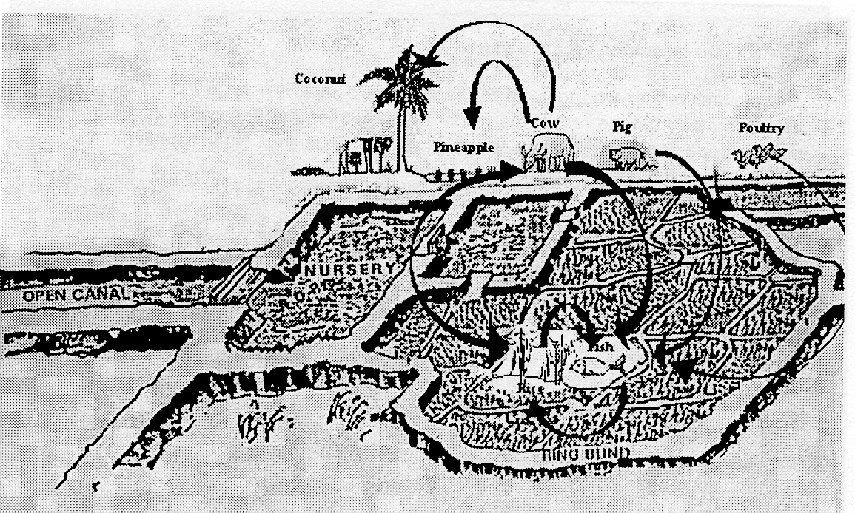
Rice--fish multi-tier Integrated Farming System: On -farm model

Slide 19
Environmental superiority of IFS over mono-crop rice
Avoidance of pesticides in IFS - makes it ecologically superior to rice farming
Alternating rice and fish - disrupts life cycle of rice pests
Weeds are destroyed by fish such as grass carp
Rice yield was higher when preceded by fish farming
Critical environmental parameters in IFS found to be congenial to sustain high biomass production
High sediment organic carbon content in IFS demonstrate the beneficial effects of organic enrichment

Slide 20
IFS- - Economic Gains
IFS reduce dominant cost of inputs in rice:
Savings due to reduction in fertilisers and pesticides to maintain the ecological quality of the rice field for fish farming.
IFS reduce labour costs in rice:
Dominant cost of weeding is completely saved
Bottom-dwelling fish level the ground and save the cost for land preparation.

Slide 21
Solution
Win—Win Model ?

Slide 22

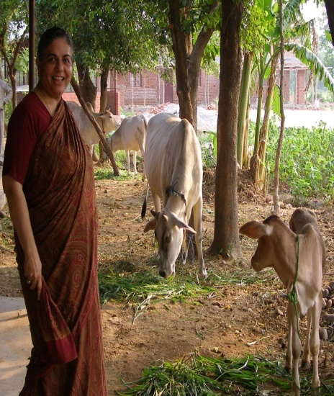
Environmental Resources, Governance, and Conflicts
Environmental Conflict in India ?
1982, The Research Foundation for Science, Technology and Ecology in Dehra Dun
The Violence of the Green Revolution and Monocultures of the Mind , Biopiracy, Stolen Harvest and Water Wars
Founder of Navdanys, 1991
Vandana Shiva
Dr Shiva at Bija Vidyapeeth

Slide 23
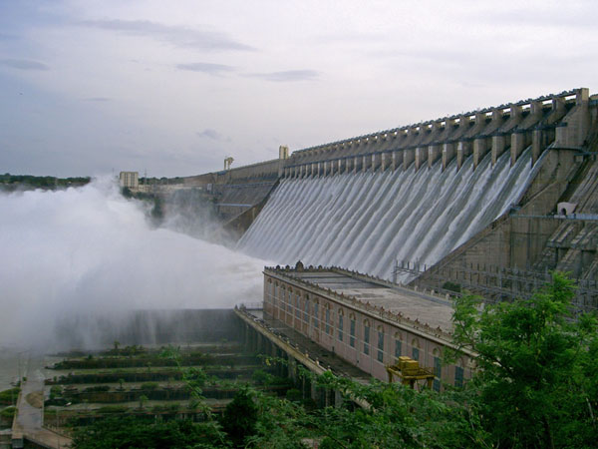
Conflict over Dams and Multi Purpose Projects:
Water & Big Dams

Slide 24
Large dams and development
  “DAMS ARE THE TEMPLES OF MODERN INDIA” …

Slide 25
Development aspect
Irrigation management , use of floodwaters, generation of hydropower, water supplies to expanding urban centres and industries
1930’s – 70’s : large dams synonymous with development and economic progress
Dams – the single most important & efficient intervention
  Water and energy requirement of growing population
  Multiple benefits : regional development, job creation, fostering industries with export capability
  Income from export earnings

Slide 26
Various Examples :
Mulsi Satyagraha (World War I) ledby Pandurang Mahadev Bapat, 1920-21
Bhakra-Nangal
Tungabhadra
Hirakud
After 70s
Tehri
SSP
November 7, 20262/24/10

Slide 27
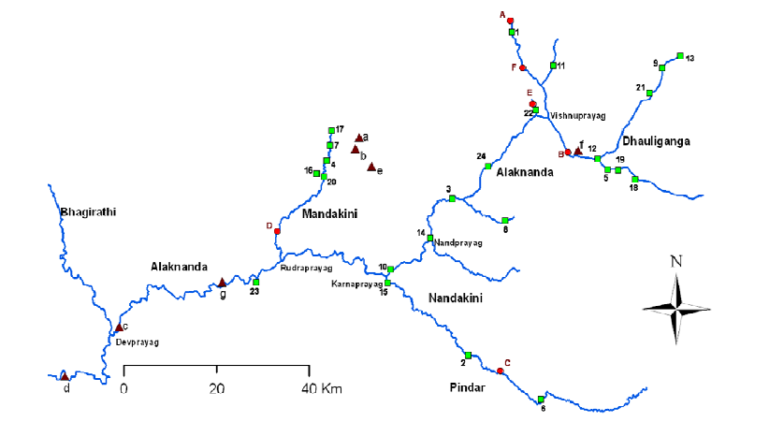
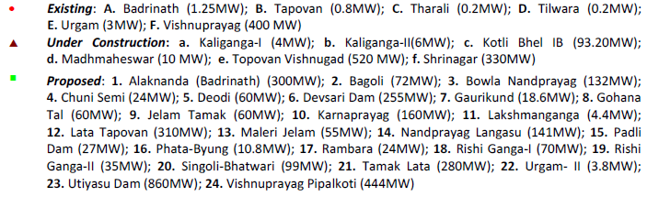
Existing capacity: 405.9 MW
Under construction: 963.2 MW
Proposed: 3505.6 MW
Source: GRBMP, 2010
November 7, 20262/24/10

Slide 28
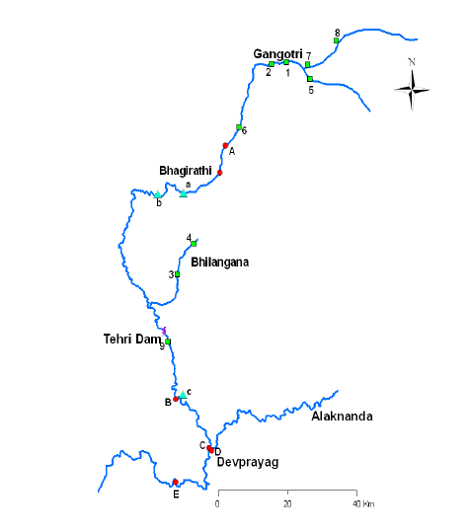
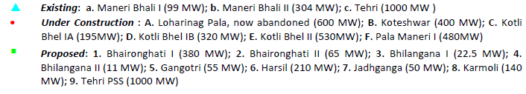
Existing capacity: 1403MW
Under construction: 2525 MW
Proposed Projects: 1933.5 MW
Source: GRBMP, 2010
November 7, 20262/24/10

Slide 29
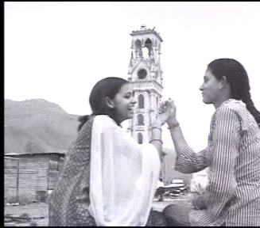
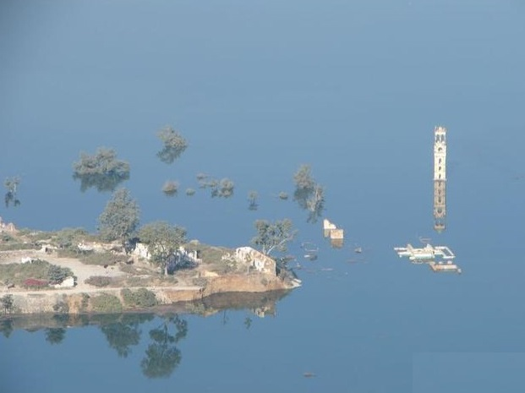
Submergence due to Tehri Dam
After Submergence
Before Submergence
November 7, 20262/24/10

Slide 30
What is the debate about ???
  Proponents
    Dams- the most competitive option
    Social & economic development demands
  Opponents
    Debt burden &cost overruns,
    displacement & impoverishment of people,
    destruction of ecosystem,
    inequitable sharing of costs & benefits
Degradation of environmental resources
November 7, 20262/24/10
27-02-2009
November 7, 20262/24/10

Slide 31
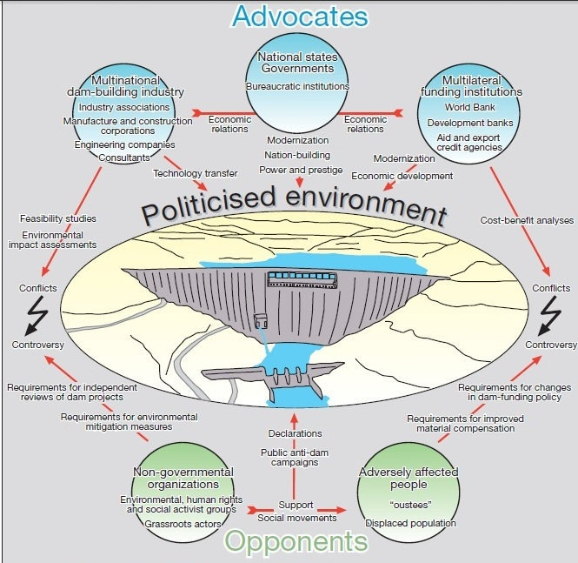
Source: NÜSSER, MARCUS (2003). Political Ecology of Large Dams: A Critical Review. Petermanns Geographische Mitteilungen

Slide 32
Main actors in the large dam debate
The controversy between advocates and opponents of large dams takes place in a politicised environment.
Actors in the discussion on large dams are national states and governmental institutions, dam building industry associations and engineering companies, multilateral funding institutions, environmental non-governmental activist groups, and the adversely affected people.
November 7, 20262/24/10

Slide 33
Development through dams? Cost-benefit approach
November 7, 20262/24/10

Slide 34
Benefits and Costs as Political Arithmetic
The large dam is always announced as a techno-economic decision.
Typically, quantification is pursued; which boils down to the search for an acceptable cost-benefit ratio for the project.
Ideally, the benefits are expected to outnumber the costs. However, the cost-benefit ratio is rarely, if ever, arrived at neatly.
In great measure, much of the confusion springs from the contested and political nature of how values and prices are determined.
For the controversial Sardar Sarovar Project, study records how different cost-benefit outcomes were politically arrived at rather than being based on objective criteria
Source: http://monthlyreview.org/2008/07/01/framing-indias-hydraulic-crisis-the-politics-of-the-modern-large-dam by Rohan D’Souza

Slide 35
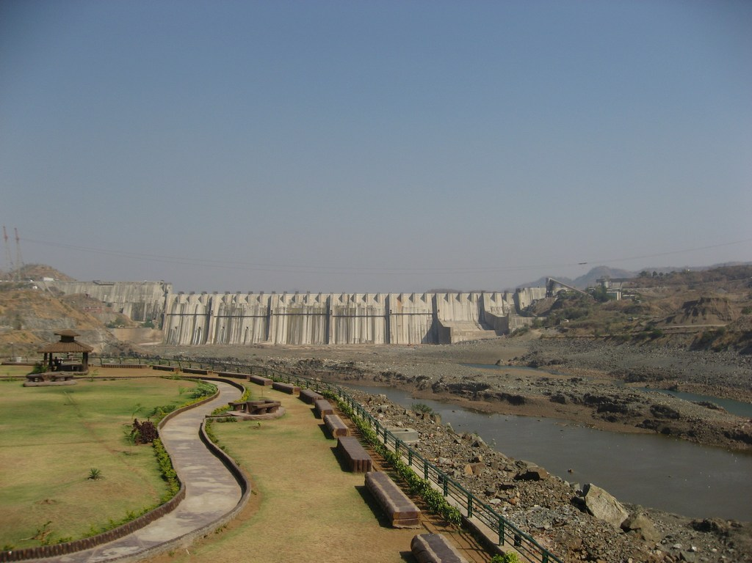
SARDAR SROVAR PROJECT : The War of Attrition

Slide 36
Bio-physical impacts | Pro dam Perspective | Critics
Water quality | Reservoir may store heavy metals and prevent downstream contamination. | Reservoir may change the cycling of nutrients and carbon, decrease dissolved oxygen and total suspended solids Alter seasonal temperature patterns and affect the growth of periphyton, and so affeact fisheries
Impact area | - | Aquatic, riparian and terrestrial habitats for endemic or rare species may be disturbed or destroyed
Sediment | Reservoir may store anthropogenic sources of sediment and decrease turbidity and sediment aggradation downstream. | Reservoir may disrupt natural longitudinal sediment movement; downstream channel may degrade; downstream grain size distribution may change; depositional features (bars, islands, deltas) and channel morphology (width, depth, sinuosity) may change. These changes may result in habitat loss, streambank instability and impacts to water infrastructure.
Source: Water alternatives journals

Slide 37
Bio-physical impacts | Pro dam Perspective | Critics
Biodiversity | Reservoir may create potential habitat or reduce competition or predation for rare/endemic species | Lotic and terrestrial habitats of rare or endemic species may be destroyed migration routes may be interrupted
Natural flow regime | Dam may reregulate altered flows (if dam is mostly downstream of a series of dams). | Dam may change historic hydrograph – magnitude, duration, timing, and frequency of high and low flows; may cause downstream degradation negative ecological impacts of flow modification are extensive.
Climate change and air quality | Generation of hydropower may reduce emissions of greenhouse gases (GHG) and particulates | Methane emissions due to decomposing organic material in reservoirs add to GHG emission
Landscape stability |  | Reservoir may induce seismicity, Road construction may increase landslide potential.
Source: Water alternatives journals

Slide 38
Socio-Economic impacts | Pro dam Perspective | Critics
Social capital | Dams may integrate less accessible portions of communities with the rest of the community | People from one community may be resettled into multiple new communities, disrupting social cohesion.
Cultural change | Dams may instill national pride | Inundation of tombs, religious sites and other areas of cultural significance; loss of traditional knowledge regarding the ecosystem.
Local hydropower access | Communities that were once isolated or that relied on small hydro or alternative forms of electricity generation may be connected to the grid | Prices of electricity may rise as the source of power may be further away
Health impacts | Water treatment facilities may improve the quality of drinking water | The prevalence of malaria, schistosomiasis and other water-borne diseases may increase as the breeding grounds for hosts increases
Source: Water alternatives journals

Slide 39
ISSUES OF DISPLACEMENT THROUGH DAM BUILING ACTIVITIES

Slide 40
Magnitudes
21.3 million of Displaced Population/PAPs in India for the period of 1951-52;
60 million- 1947-2000
State to state basis-
W.B. – 7 million out of 60 million
Assam- 1.9 million
Gujrat- 7 million
% of Resettlement
Odisha- 35.27 of the DP since 1951-95
A.P.- 28.82
W.B.- 9 % of its 3.7 million DPs

Slide 41
Rethinking Cost-benefit Analysis
Gap between project planning & implementation
1980s (study by Parliament public accounts committee)- no dam had been built at less than 500 % cost overrun, capacity utilization of most dams was below 50 % of what was planned.
Social costs?

